Slide 1

Space-Time Neural Operator Based Video Enhancement System
Major Project Review - 1
Batch ID: AIM-B12
Project Guide
Project Batch Members
Panchumarthi Tarun | 24BQ5A6111
MULLA ASHRAF ALI | 23BQ1A6190
PANGA CHINNA KONDAIAH | 24BQ5A6133
KANCHARAGUNTA SAI INDRANEEL | 23BQ1A6155
Mrs Deepthi Ketineni (assistant professor)

Slide 2
Guide: Mrs Deepthi Ketineni Asst. Prof.
Batch ID:AIM-B12
24BQ5A6111, 23BQ1A6190,
24BQ5A6133, 23BQ1A6155
Space-Time Neural Operator Based Video Enhancement System
Problem statement :
Low-resolution videos have poor visual details and clarity.
Low-frame-rate videos often have jerky or non-smooth motion.
Existing methods usually handle resolution enhancement and frame interpolation separately
This can cause loss of details and motion inconsistencies.
Complex movements can lead to inaccurate motion estimation and visual artifacts.
There is a need to jointly learn spatial and temporal information.
The proposed system uses Space-Time Neural Operators (STNO) to enhance both video quality and frame rate.

Slide 3
Guide: Mrs Deepthi Ketineni Asst. Prof.
Batch ID:AIM-B12
24BQ5A6111, 23BQ1A6190,
24BQ5A6133, 23BQ1A6155
Space-Time Neural Operator Based Video Enhancement System
Literature Review
Ref 01 –Space-Time Video Super-resolution with Neural Operator
Y. Zhang et al., 2024 | arXiv Preprint (Base Paper)
| Proposed Method | Data & Setup | key Results | Strengths & Limitations | Relevance to my research |
Proposed a Space-Time Neural Operator (STNO) based video enhancement framework.
Extracts multi-scale spatial features from consecutive low-resolution video frames.
Uses Galerkin-type attention to capture global motion and texture information efficiently.
Performs motion estimation and temporal interpolation jointly to handle large and complex movements.
Uses bidirectional temporal propagation to aggregate information from neighboring frames.
Applies spatial modulation to generate high-resolution frames at the desired scale.
Produces high-resolution and high-frame-rate videos with improved details and smoother motion.
Dept. AIM @ VVIT

Slide 4
Guide: Mrs Deepthi Ketineni Asst. Prof.
Batch ID:AIM-B12
24BQ5A6111, 23BQ1A6190,
24BQ5A6133, 23BQ1A6155
Space-Time Neural Operator Based Video Enhancement System
Literature Review
Ref 01 –Space-Time Video Super-resolution with Neural Operator
Y. Zhang et al., 2024 | arXiv Preprint (Base Paper)
| Proposed Method | Data & Setup | key Results | Strengths & Limitations | Relevance to my research |
Uses Vimeo-90K-T as the primary dataset for space-time video super-resolution evaluation.
Evaluates the method on Vid4, Adobe, GoPro, and SPMCS datasets for different video enhancement tasks.
Input consists of consecutive low-resolution video frames for joint spatial and temporal enhancement.
Uses multi-scale feature extraction to capture fine details, object structures, and large motion.
Employs Galerkin-type attention to learn global motion and texture relationships between video frames.
Uses forward and backward temporal propagation to aggregate information from neighboring frames.
Evaluates performance using PSNR(Peak Signal-to-Noise Ratio), SSIM(Structural Similarity Index Measure), inference speed, and computational complexity.

Slide 5
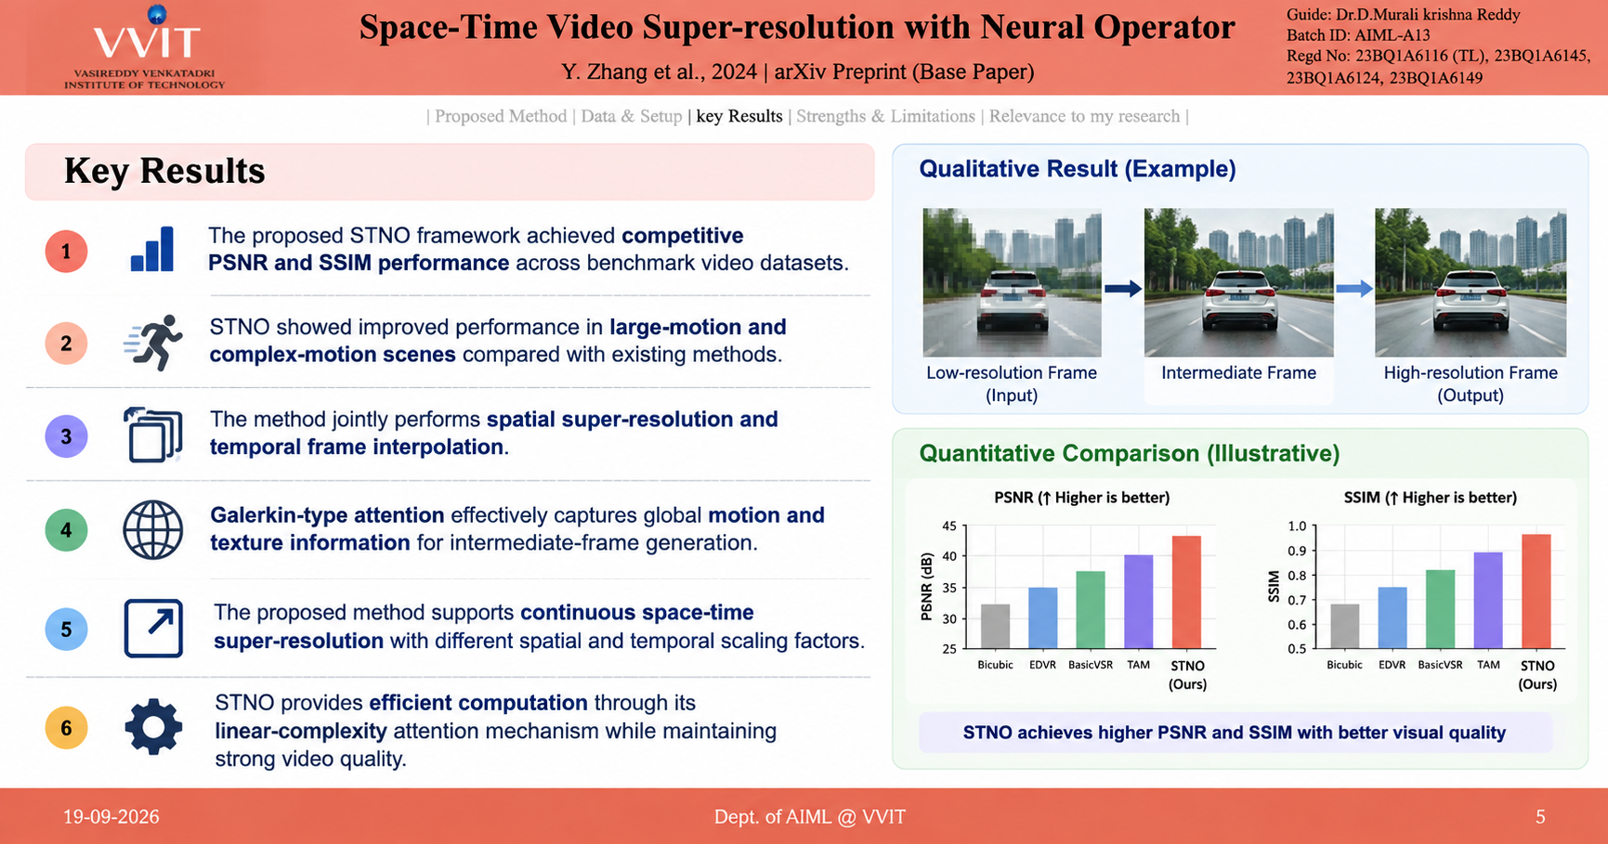
Guide: Mrs Deepthi Ketineni Asst. Prof.
Batch ID:AIM-B12
24BQ5A6111, 23BQ1A6190,
24BQ5A6133, 23BQ1A6155
Space-Time Neural Operator Based Video Enhancement System
Literature Review
Ref 01 –Space-Time Video Super-resolution with Neural Operator
Y. Zhang et al., 2024 | arXiv Preprint (Base Paper)
| Proposed Method | Data & Setup | key Results | Strengths & Limitations | Relevance to my research |
The proposed STNO framework achieved competitive PSNR and SSIM performance across benchmark video datasets.
STNO showed improved performance in large-motion and complex-motion scenes compared with existing methods.
The method jointly performs spatial super-resolution and temporal frame interpolation.
Galerkin-type attention effectively captures global motion and texture information for intermediate-frame generation.
The proposed method supports continuous space-time video super-resolution with different spatial and temporal scaling factors.
STNO provides efficient computation through its linear-complexity attention mechanism while maintaining strong video quality.

Slide 6
Guide: Mrs Deepthi Ketineni Asst. Prof.
Batch ID:AIM-B12
24BQ5A6111, 23BQ1A6190,
24BQ5A6133, 23BQ1A6155
Space-Time Neural Operator Based Video Enhancement System
Literature Review
Ref 01 –Space-Time Video Super-resolution with Neural Operator
Y. Zhang et al., 2024 | arXiv Preprint (Base Paper)
| Proposed Method | Data & Setup | key Results | Strengths & Limitations | Relevance to my research |
Strengths
Limitations
Joint spatial-temporal enhancement in a single framework.
Multi-scale features capture details and large motion.
Galerkin-type attention efficiently captures global motion and texture.
Handles large and complex motion effectively.
Supports continuous space-time super-resolution.
Maintains efficient computation with good video quality.
Complex architecture with multiple processing stages.
Requires high computational resources.
May face challenges with extreme motion.
Requires large datasets and training resources.
Mainly focuses on STVSR, not general video restoration

Slide 7
Guide: Mrs Deepthi Ketineni Asst. Prof.
Batch ID:AIM-B12
24BQ5A6111, 23BQ1A6190,
24BQ5A6133, 23BQ1A6155
Space-Time Neural Operator Based Video Enhancement System
Literature Review
Ref 01 –Space-Time Video Super-resolution with Neural Operator
Y. Zhang et al., 2024 | arXiv Preprint (Base Paper)
| Proposed Method | Data & Setup | key Results | Strengths & Limitations | Relevance to my research |
Space-Time Neural Operator (STNO) provides the base framework for our video enhancement project.
Supports joint spatial and temporal enhancement.
Multi-scale features help capture details and large motion.
Galerkin-type attention learns global motion and texture relationships.
Forward/backward propagation uses information from neighboring frames.
Supports generation of high-resolution, high-frame-rate videos

Slide 8
Guide: Mrs Deepthi Ketineni Asst. Prof.
Batch ID:AIM-B12
24BQ5A6111, 23BQ1A6190,
24BQ5A6133, 23BQ1A6155
Space-Time Neural Operator Based Video Enhancement System
Literature Review
Ref 02-Enhancing Space-Time Video Super-Resolution via Spatial–Temporal Feature Interaction
Yue et al., 2025 | Neural Networks
| Proposed Method | Data & Setup | key Results | Strengths & Limitations | Relevance to my research |
Proposed an end-to-end Spatial–Temporal Feature Interaction Network (STINet) for Space-Time Video Super-Resolution.
ST-FI: Generates intermediate LR and HR frame features while allowing them to interact.
ST-LR: Performs local refinement using information from neighboring frames and motion cues.
ST-GR: Uses a Graph Convolutional Network (GCN) to exchange global spatial-temporal information between frames and resolutions.
Motion Consistency Loss: Helps maintain smooth and continuous motion between reconstructed frames.
LR–HR Feature Fusion: Combines the refined LR and HR features to reconstruct the final video.
Produces a high-resolution and high-frame-rate video from a low-resolution, low-frame-rate input.

Slide 9
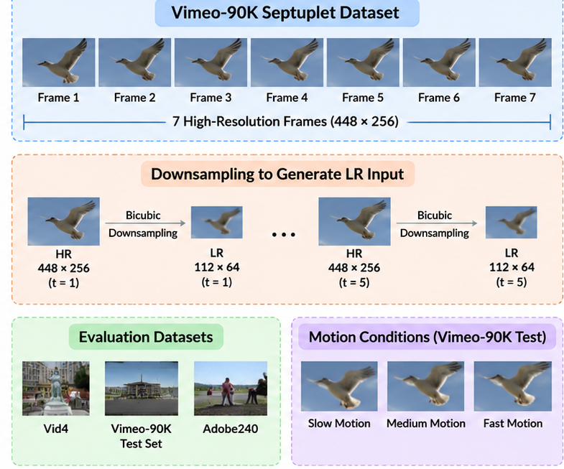
Guide: Mrs Deepthi Ketineni Asst. Prof.
Batch ID:AIM-B12
24BQ5A6111, 23BQ1A6190,
24BQ5A6133, 23BQ1A6155
Space-Time Neural Operator Based Video Enhancement System
Literature Review
Ref 02-Enhancing Space-Time Video Super-Resolution via Spatial–Temporal Feature Interaction
Yue et al., 2025 | Neural Networks
| Proposed Method | Data & Setup | key Results | Strengths & Limitations | Relevance to my research |
Uses the Vimeo-90K Septuplet dataset containing 91,701 video sequences.
Each sequence contains 7 high-resolution frames with a resolution of 448 × 256.
Odd-indexed frames are downsampled to 112 × 64 using bicubic interpolation to generate low-resolution inputs.
Vid4, Vimeo-90K test set, and Adobe240 are used for performance evaluation.
Vimeo-90K test videos are evaluated under slow, medium, and fast motion conditions.
Training is performed for 500,000 iterations using Adam optimizer, batch size 30, and 4 NVIDIA RTX 2080 GPUs.
Performance is evaluated using PSNR, SSIM, LPIPS, inference speed, and number of parameters

Slide 10
Guide: Mrs Deepthi Ketineni Asst. Prof.
Batch ID:AIM-B12
24BQ5A6111, 23BQ1A6190,
24BQ5A6133, 23BQ1A6155
Space-Time Neural Operator Based Video Enhancement System
Literature Review
Ref 02-Enhancing Space-Time Video Super-Resolution via Spatial–Temporal Feature Interaction
Yue et al., 2025 | Neural Networks
| Proposed Method | Data & Setup | key Results | Strengths & Limitations | Relevance to my research |
Achieves strong Peak Signal-to-Noise Ratio, Structural Similarity Index, and Learned Perceptual Image Patch Similarity performance on Vid4, Vimeo-90K, and Adobe240 benchmarks.
STINet outperforms existing state-of-the-art Space-Time Video Super-Resolution methods across the evaluated benchmarks.
Spatial-Temporal feature interaction improves the reconstruction of fine details and motion information.
Spatial-Temporal Global Refinement with Graph Convolutional Network improves global spatial-temporal feature refinement and long-term temporal consistency.
Motion Consistency Loss improves the continuity and smoothness of motion between reconstructed frames.
Supports multi-frame interpolation, reconstructing 3, 5, 7, and 9 intermediate frames.
Achieves 15.33 frames per second inference speed with 10.89 million parameters.

Slide 11
Guide: Mrs Deepthi Ketineni Asst. Prof.
Batch ID:AIM-B12
24BQ5A6111, 23BQ1A6190,
24BQ5A6133, 23BQ1A6155
Space-Time Neural Operator Based Video Enhancement System
Literature Review
Ref 02-Enhancing Space-Time Video Super-Resolution via Spatial–Temporal Feature Interaction
Yue et al., 2025 | Neural Networks
| Proposed Method | Data & Setup | key Results | Strengths & Limitations | Relevance to my research |
Strengths
Limitations
Spatial-temporal feature interaction improves details and motion.
ST-FI generates intermediate LR and HR features.
ST-LR and ST-GR provide local and global refinement.
GCN-based ST-GR improves information exchange across frames.
Motion Consistency Loss maintains smooth motion.
Supports 3, 5, 7, and 9 frame interpolation.
Complex multi-stage architecture.
Optical-flow and deformable processing add overhead.
GCN-based refinement increases complexity.
Requires large datasets and multiple GPUs.
Real-time inference needs further improvement.

Slide 12
Guide: Mrs Deepthi Ketineni Asst. Prof.
Batch ID:AIM-B12
24BQ5A6111, 23BQ1A6190,
24BQ5A6133, 23BQ1A6155
Space-Time Neural Operator Based Video Enhancement System
Literature Review
Ref 02-Enhancing Space-Time Video Super-Resolution via Spatial–Temporal Feature Interaction
Yue et al., 2025 | Neural Networks
| Proposed Method | Data & Setup | key Results | Strengths & Limitations | Relevance to my research |
Supports joint spatial and temporal video enhancement.
Spatial-temporal feature interaction improves video quality.
ST-FI helps generate better intermediate frames.
ST-LR and ST-GR handle local and global motion.
GCN-based feature exchange improves cross-frame information sharing.
Motion Consistency Loss maintains smooth motion.
Provides a reference method for our STNO-based system.

Slide 13
Guide: Mrs Deepthi Ketineni Asst. Prof.
Batch ID:AIM-B12
24BQ5A6111, 23BQ1A6190,
24BQ5A6133, 23BQ1A6155
Space-Time Neural Operator Based Video Enhancement System
Literature Review
Ref 03-MamEVSR: Event-based Video Super-Resolution via State Space Models
Xiao et al., 2025
| Proposed Method | Data & Setup | key Results | Strengths & Limitations | Relevance to my research |
Uses Mamba-based State Space Models for video super-resolution.
Frame Feature Encoder extracts features from low-resolution frames.
Event Feature Encoder converts event data into useful features.
Interleaved Mamba (iMamba) captures information between adjacent frames.
Cross-Modality Mamba (cMamba) combines RGB and event information.
Bidirectional propagation uses both forward and backward temporal information.
A Reconstructor with Pixel Shuffle generates the final high-resolution video frames.

Slide 14
Guide: Mrs Deepthi Ketineni Asst. Prof.
Batch ID:AIM-B12
24BQ5A6111, 23BQ1A6190,
24BQ5A6133, 23BQ1A6155
Space-Time Neural Operator Based Video Enhancement System
Literature Review
Ref 03-MamEVSR: Event-based Video Super-Resolution via State Space Models
Xiao et al., 2025
| Proposed Method | Data & Setup | key Results | Strengths & Limitations | Relevance to my research |
Uses the REDS dataset and Color Event Dataset for training and evaluation.
REDS4 is used for 4× video super-resolution evaluation with simulated event data.
Color Event Dataset contains synchronized RGB frames and event data captured using a DAVIS346 event camera.
Uses 15 input frames with an input resolution of 64 × 64 pixels during training.
Trained for 300,000 iterations using the Adam optimizer with a Cosine Annealing learning rate scheduler.
Training is conducted using 2 NVIDIA RTX 3090 graphics processing units.
Performance is evaluated using Peak Signal-to-Noise Ratio and Structural Similarity Index.

Slide 15
Guide: Mrs Deepthi Ketineni Asst. Prof.
Batch ID:AIM-B12
24BQ5A6111, 23BQ1A6190,
24BQ5A6133, 23BQ1A6155
Space-Time Neural Operator Based Video Enhancement System
Literature Review
Ref 03-MamEVSR: Event-based Video Super-Resolution via State Space Models
Xiao et al., 2025
| Proposed Method | Data & Setup | key Results | Strengths & Limitations | Relevance to my research |
MamEVSR consistently outperforms existing methods on the evaluated event-based video super-resolution datasets.
Achieves 32.94 dB Peak Signal-to-Noise Ratio and 0.9195 Structural Similarity Index on the REDS4 four-times evaluation.
Achieves 41.14 dB Peak Signal-to-Noise Ratio and 0.9831 Structural Similarity Index on the CED two-times evaluation.
Interleaved Mamba and Cross-Modality Mamba significantly contribute to reconstruction performance.
Bidirectional propagation improves the use of temporal information across frames.
Produces sharper details and textures, including wheel and license-plate regions, closer to the ground-truth images.
Provides high reconstruction quality with efficient computation and a modest parameter count.

Slide 16
Guide: Mrs Deepthi Ketineni Asst. Prof.
Batch ID:AIM-B12
24BQ5A6111, 23BQ1A6190,
24BQ5A6133, 23BQ1A6155
Space-Time Neural Operator Based Video Enhancement System
Literature Review
Ref 03-MamEVSR: Event-based Video Super-Resolution via State Space Models
Xiao et al., 2025
| Proposed Method | Data & Setup | key Results | Strengths & Limitations | Relevance to my research |
Strengths
Limitations
Mamba-based architecture provides efficient global feature modeling.
Interleaved Mamba enables effective bidirectional feature fusion.
Cross-Modality Mamba combines frame and event information for better motion details.
Bidirectional propagation uses information from both temporal directions.
Achieves high reconstruction quality on REDS4 and CED datasets.
Provides efficient computation with a modest number of parameters.
Struggles to recover very fine textures when input information is insufficient.
Low-resolution event data may not provide enough detailed information.
RGB information loss can affect texture reconstruction.
Requires event data, which is not available in standard video datasets.
The paper suggests using longer temporal sequences to improve texture recovery.
Future work includes developing lighter-weight modules and extending the method to other video restoration tasks

Slide 17
Guide: Mrs Deepthi Ketineni Asst. Prof.
Batch ID:AIM-B12
24BQ5A6111, 23BQ1A6190,
24BQ5A6133, 23BQ1A6155
Space-Time Neural Operator Based Video Enhancement System
Literature Review
Ref 03-MamEVSR: Event-based Video Super-Resolution via State Space Models
Xiao et al., 2025
| Proposed Method | Data & Setup | key Results | Strengths & Limitations | Relevance to my research |
Mamba-based feature modeling provides an alternative approach for efficient video enhancement.
Bidirectional propagation supports the use of information from neighboring frames.
Cross-modality feature fusion provides ideas for combining different video information.
Interleaved Mamba can inspire efficient spatio-temporal feature processing.
Event-based motion information can help handle complex and fast motion.
The method provides useful ideas for improving detail reconstruction and motion consistency.
Supports the development of our Space-Time Neural Operator based video enhancement system.

Slide 18
Guide: Mrs Deepthi Ketineni Asst. Prof.
Batch ID:AIM-B12
24BQ5A6111, 23BQ1A6190,
24BQ5A6133, 23BQ1A6155
Space-Time Neural Operator Based Video Enhancement System
Literature Review - Summary
Reference | Year | Main Idea | Strengths | Limitations
Zhang et al. (STNO) base paper | 2024 | Neural Operator + Galerkin Attention for STVSR | Global motion modeling; linear complexity; fast | Limited intra-frame modeling; end-to-end enhancement remains future work
Yue & Shi (STINet) | 2025 | Spatial-temporal feature interaction for STVSR | LR-HR interaction; local/global refinement; motion consistency | Complex architecture; higher implementation/training cost
MamEVSR | 2025 | Event-based video super-resolution using Mamba-based state space models | Efficient temporal feature fusion; combines RGB and event information; improves motion details | Requires event data; struggles with very fine textures; real-world event data can be limited

Slide 19
Guide: Mrs Deepthi Ketineni Asst. Prof.
Batch ID:AIM-B12
24BQ5A6111, 23BQ1A6190,
24BQ5A6133, 23BQ1A6155
Space-Time Neural Operator Based Video Enhancement System
Review – 1
Questions?

